Slide 1
Inconvenient Mathematics: Why Data Scientists Can’t Give Ugly Ducklings a Free Lunch
Craig Savage, PhD, MBA
Citizens Data Scientists - Melbourne

Slide 2
Disclosures

Slide 3
Introduction
To me and to this talk

Slide 4
Introduction: Personal

Slide 5
Introduction: Personal
Education in technical fields and business
PhD in Electrical Engineering and MBA

Slide 6
Introduction: Personal
Education in technical fields and business
PhD in Electrical Engineering and MBA
Roughly 20 years experience in industry:
Defence
Biomedical Engineering
Banking (Risk)

Slide 7
Introduction: Personal
Education in technical fields and business
PhD in Electrical Engineering and MBA
Roughly 20 years experience in industry:
Defence
Biomedical Engineering
Banking (Risk)
Motivated by implementation of systems
Flight tests
Patient trials
Customer assessment
Goal is to have a measurable impact

Slide 8
Introduction: Data Science
Data science is a widely used yet loosely defined term
Reporting summary statistics?
Predictive analytics?
Data visualisation?
All of the above?

Slide 9
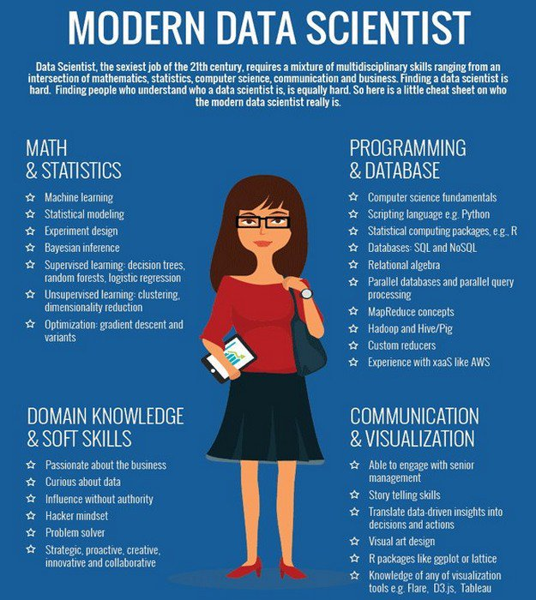
Introduction: Data Science
Data science is a widely used yet loosely defined term
Reporting summary statistics?
Predictive analytics?
Data visualisation?
All of the above?
http://datadriven.tv/blog/modern-data-scientist-infographic/

Slide 10
Introduction: Data Science
Data science is a widely used yet loosely defined term
Reporting summary statistics?
Predictive analytics?
Data visualisation?
All of the above?
Regression and Classification Problems
If nothing else, agree that data driven decisions are better than dogma

Slide 11
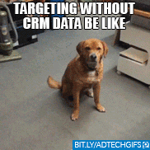
Introduction: Data Science
Data science is a widely used yet loosely defined term
Reporting summary statistics?
Predictive analytics?
Data visualisation?
All of the above?
Regression and Classification Problems
If nothing else, agree that data driven decisions are better than dogma

Slide 12
Data
Application examples

Slide 13
Data
Melbourne House Price Data
Public Kaggle data set – Melbourne Housing Market
https://www.kaggle.com/anthonypino/melbourne-housing-market
~60k rows of 13 variables (“Small” data set)
Filters:
Houses (not flats, etc)
Melbourne Metro (i.e. not rural)
“Reasonableness”: 0 < # Bedrooms <=5, Garage for <=4 cars, etc….
Regression: Predict house prices (continuous)
Classification: Determine whether a house is a “good deal” (binary)

Slide 14
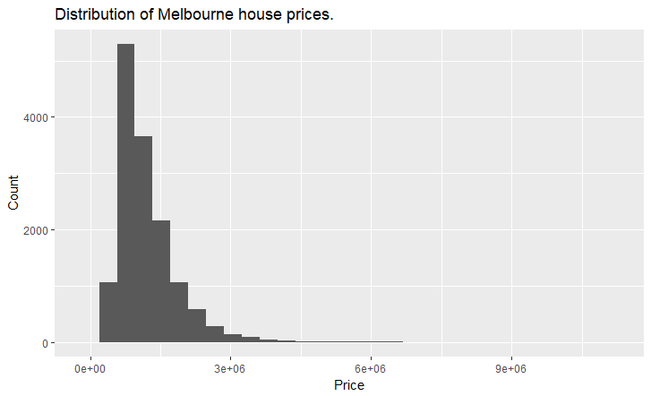
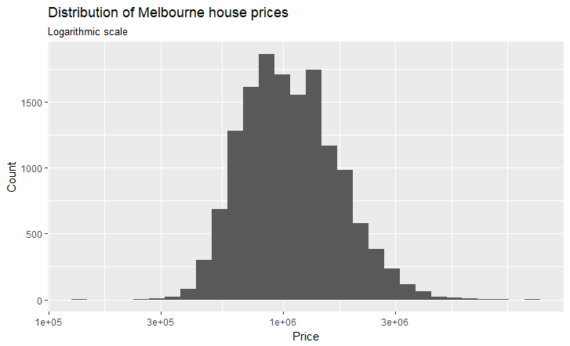
Data
Price Distribution
Price Distribution (Log Scale)

Slide 15
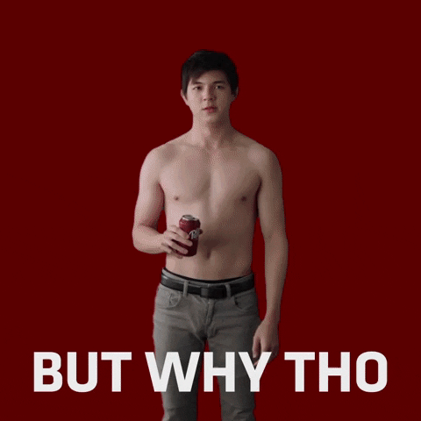
Data
Price Distribution
Price Distribution (Log Scale)

Slide 16
Regression
Predict a continuous variable: Price

Slide 17
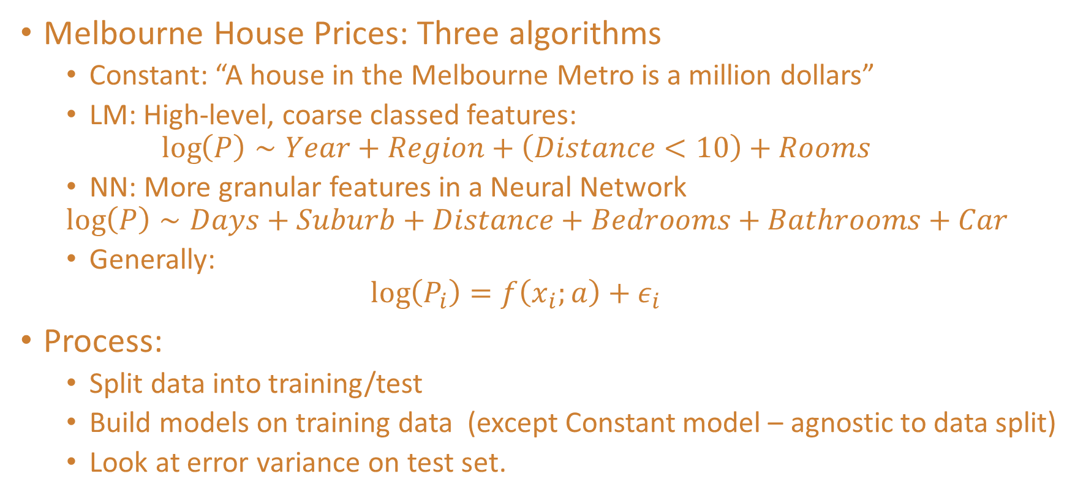
Regression: Example
Melbourne House Prices: Three algorithms
Constant: “A house in the Melbourne Metro is a million dollars”
LM: High-level, coarse classed features:
$$\log\left(P\right)∼Year+Region+\left(Distance<10\right)+Rooms$$
NN: More granular features in a Neural Network
$$\log\left(P\right)∼Days+Suburb+Distance+Bedrooms+Bathrooms+Car$$
Generally:
$$\log\left(P_{i}\right)=f\left(x_{i};a\right)+ε_{i}$$
Process:
Split data into training/test
Build models on training data (except Constant model – agnostic to data split)
Look at error variance on test set.

Slide 18
Code
R with Microsoft ML Server and RevoScaleR

Slide 19
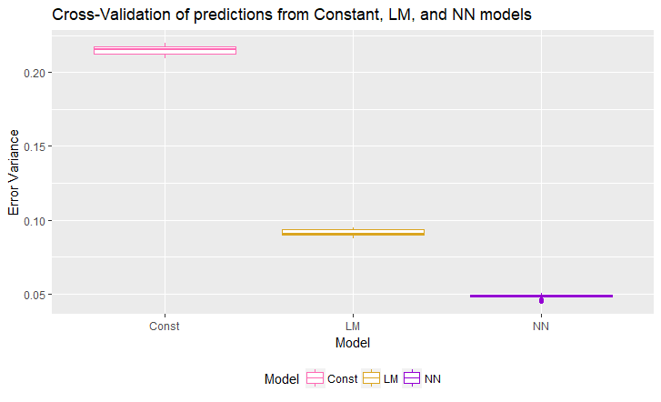
Regression: Example Results

Slide 20
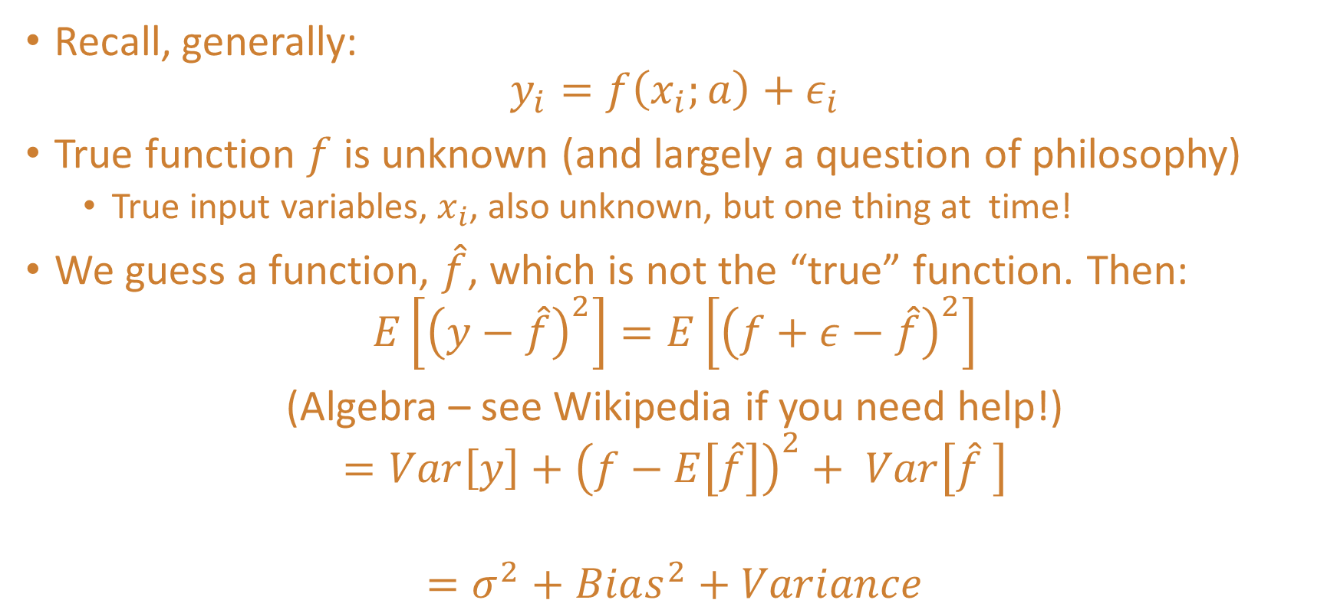
Regression: Inconvenience
Recall, generally:
$$y_{i}=f\left(x_{i};a\right)+ε_{i}$$
True function $f$ is unknown (and largely a question of philosophy)
True input variables, $x_{i}$, also unknown, but one thing at time!
We guess a function, $\hat{f}$, which is not the “true” function. Then:
$$E\left[{\left(y−\hat{f}\right)}^{2}\right]=E\left[{\left(f+ε−\hat{f}\right)}^{2}\right]$$
(Algebra – see Wikipedia if you need help!)
$$={Var\left[y\right]+\left(f−E\left[\hat{f}\right]\right)}^{2}+ Var\left[\hat{f} \right]$$
$$=σ^{2}+Bias^{2}+Variance$$

Slide 21
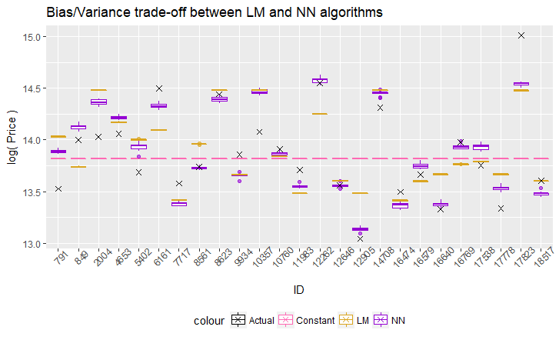
Regression: Example Results

Slide 22
Regression: Second Look
I’ve been unfair: The Bias-Variance trade-off is not solely dependent on algorithm
Number of parameters
Granularity of features
Test: Replace Region with Suburb in linear model
Repeat example, now with “LM2” algorithm

Slide 23
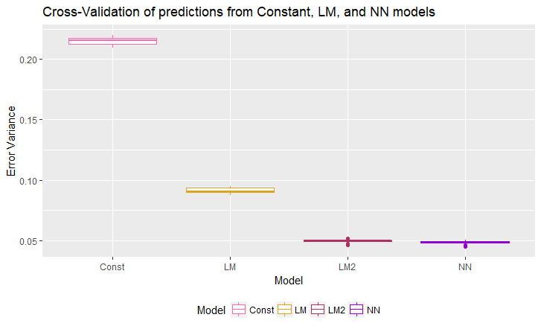
Regression: Example Results

Slide 24
Regression: Example Results

Slide 25
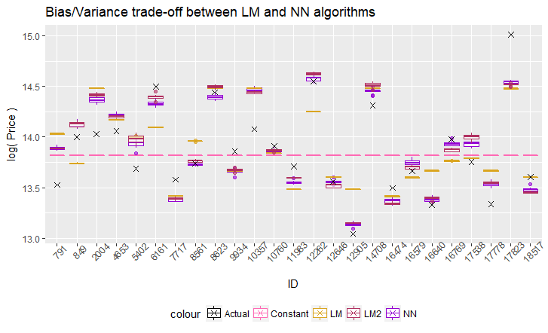
Regression: Example Results

Slide 26
Regression: Summary
Bias-Variance Trade-off: Using more granular data will (generally) help reduce error but leads to greater variance
Randomly splitting data into training/test leads to random models
Which do you pick for implementation? More on this later….
Diagnostics:
Outlier detection
Confidence intervals
Regularisation (Ridge Regression, LASSO)

Slide 27
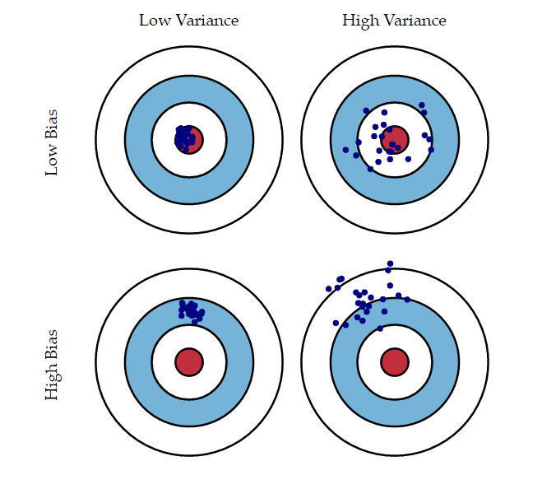
Regression: Summary
Bias-Variance Trade-off: Using more granular data will (generally) help reduce error but leads to greater variance
Randomly splitting data into training/test leads to random models
Which do you pick for implementation? More on this later….
Diagnostics:
Confidence intervals
Outlier detection
Regularisation (Ridge Regression, LASSO)
https://www.quora.com/What-is-bias-and-variance

Slide 28

Regression: Summary
Bias-Variance Trade-off: Using more granular data will (generally) help reduce error but leads to greater variance
Randomly splitting data into training/test leads to random models
Which do you pick for implementation? More on this later….
Diagnostics:
Confidence intervals
Outlier detection
Regularisation (Ridge Regression, LASSO)

Slide 29
Classification
Is this a “good deal”?

Slide 30
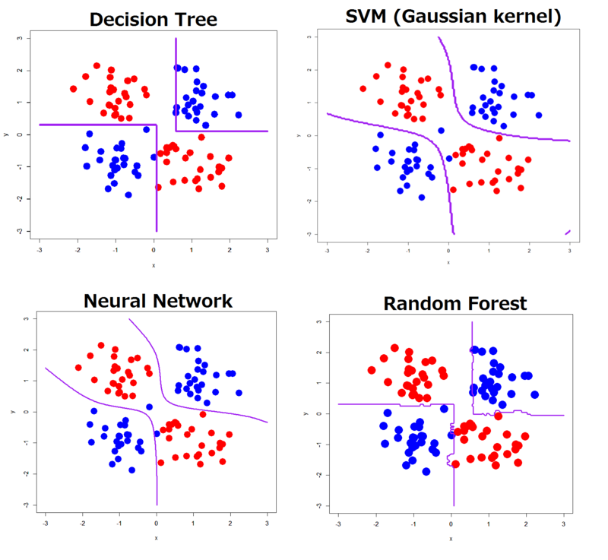
Classification: Convenient Approach
Construct mapping from input variables to binary (or multi-class) outcome flag
Regression and Threshold: Regression with discrete output
Compare to “similar” training points
Visualisation via Decision Boundary
https://www.kdnuggets.com/2015/06/decision-boundaries-deep-learning-machine-learning-classifiers.html

Slide 31
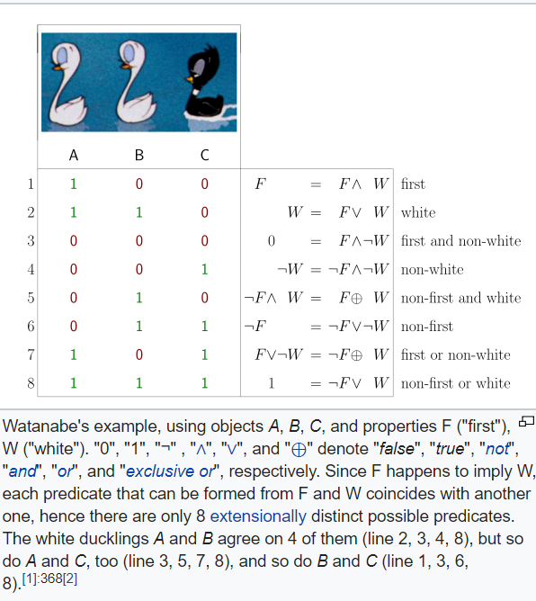
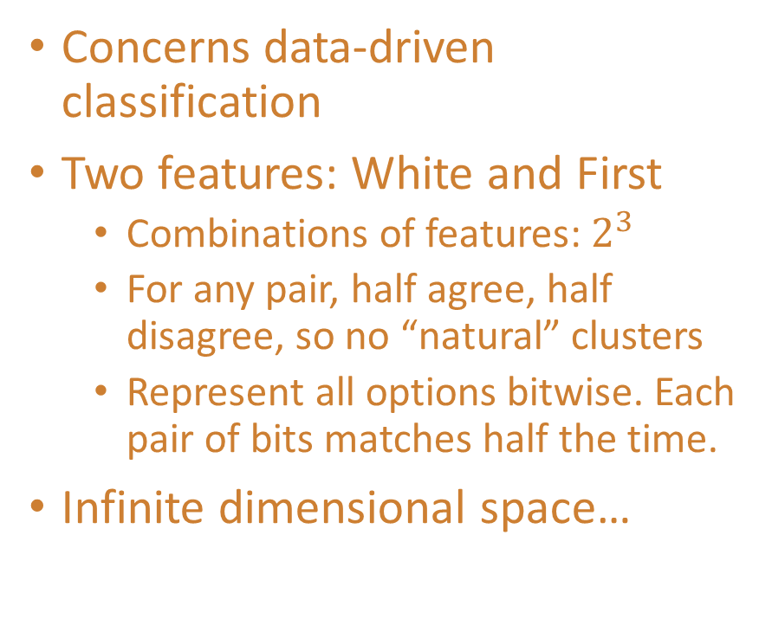
Classification: Ugly Duckling Theorem
Concerns data-driven classification
Two features: White and First
Combinations of features:${ 2}^{3}$
For any pair, half agree, half disagree, so no “natural” clusters
Represent all options bitwise. Each pair of bits matches half the time.
Infinite dimensional space…
https://commons.wikimedia.org/wiki/File:Watanabe_UglyDucklingTheorem_svg.svg

Slide 32
Classification: Example
Use the regression methods:
If Predicted > Asking price, “good deal” as true value is greater
Generate classifications on training data
Extra algorithms:
Ensemble: Take majority vote of three algorithms
Contrarian: Reverse decision of Ensemble….
Model | Prob( Good Deal )
Constant | 0.477
LM (Coarse) | 0.517
NN | 0.504
Ensemble | 0.512
Contrarian | 0.488

Slide 33
Classification: No Free Lunch Theorem
Simulated 10,000 classification outcomes
Compare performance of five algorithms

Slide 34
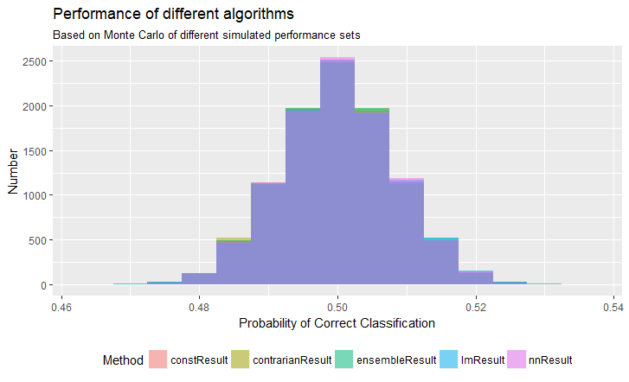
Classification: No Free Lunch Theorem
Simulated 10,000 classification outcomes
Compare performance of five algorithms

Slide 35
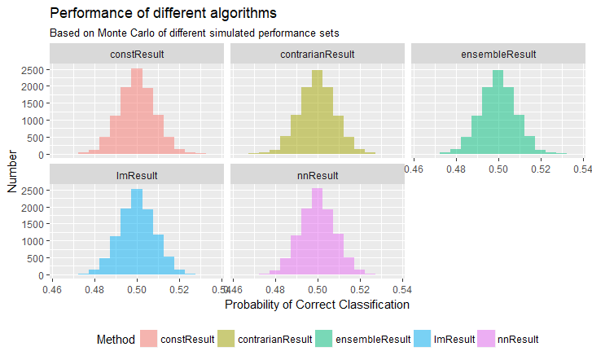
Classification: No Free Lunch Theorem
No practical difference!
Main result of the theorem: If future data are uniform, algorithms will have same average performance
Uniform not the best assumption for future data, but it’s inconvenient to say what is!
Corollary: Which model you use from Cross-Validation doesn’t matter if your future data are uniform!

Slide 36
Classification: No Free Lunch Theorem
No practical difference!
Main result of the theorem: If future data are uniform, algorithms will have same average performance
Uniform not the best assumption for future data, but it’s inconvenient to say what is!
Corollary: Which model you use from Cross-Validation doesn’t matter if your future data are uniform!
Try it on your data!

Slide 37
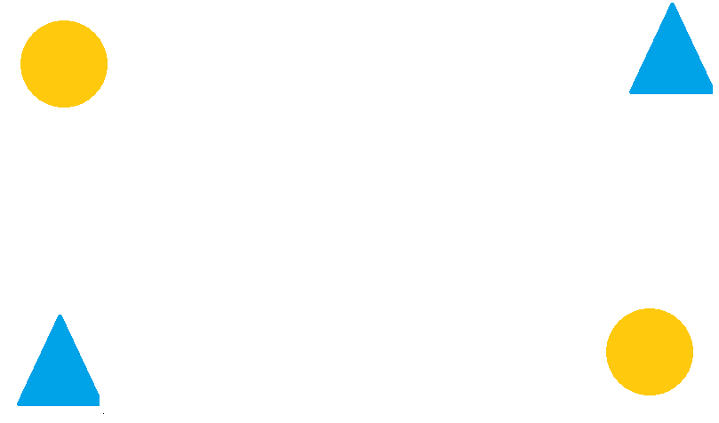
Classification: Anti-Learning
Sometimes, your training data can mislead you
Examples:
“XOR Problem”
Data sets from biology: Few patients, thousands (+) observations per patient

Slide 38
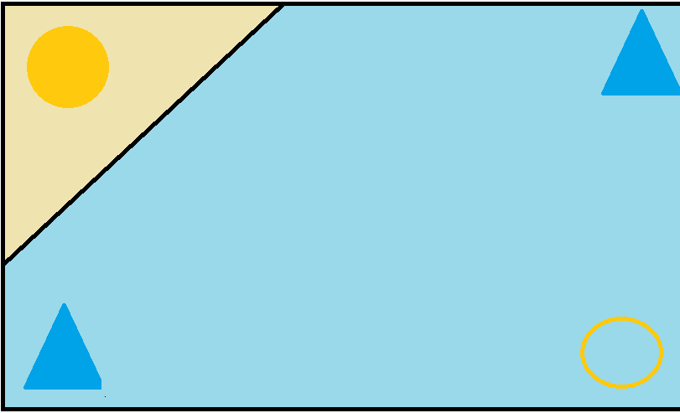
Classification: Anti-Learning
Sometimes, your training data can mislead you
Examples:
“XOR Problem”
Data sets from biology: Few patients, thousands (+) observations per patient

Slide 39

Classification: Anti-Learning
Sometimes, your training data can mislead you
Examples:
“XOR Problem”
Data sets from biology: Few patients, thousands (+) observations per patient

Slide 40

Classification: Anti-Learning
Sometimes, your training data can mislead you
Examples:
“XOR Problem”
Data sets from biology: Few patients, thousands (+) observations per patient

Slide 41
Classification: Summary
Purely data-driven classification isn’t possible:
Need to select features!
Modelling unseen data is inconvenient: How will they be distributed?
If you use your model, it won’t test your model.
If they’re uniform, then NFL may imply no algorithm is better
Anti-Learning happens sometimes

Slide 42
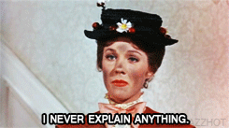
Classification: Summary
Purely data-driven classification isn’t possible:
Need to select features!
Modelling unseen data is inconvenient: How will they be distributed?
If you use your model, it won’t test your model.
If they’re uniform, then NFL may imply no algorithm is better
Anti-Learning happens sometimes

Slide 43
Conclusion
You can observe a lot by just watching.
– Yogi Berra

Slide 44
Conclusions
Inconvenient mathematical concepts in data science:
Bias-Variance Trade-off: Granularity of data & algorithm
Ugly Duckling Theorem: Must use judgment regarding “best” variables
No Free Lunch Theorem: Generalised performance is hard to estimate
Challenges:
Performance vs Interpretability
Does your model define the metric or does the metric define your model?

Slide 45
Challenges
Performance vs Interpretability:
“Like past data” is fine – even if you don’t have a mathematical definition of what “past data” means
“If the model is working, then we don’t care you can’t explain it” is logically equivalent to “If we care you can’t explain it, then the model is not working”
Better to ask: “If the model isn’t working, do you care if we can’t explain it?”
Does the model define the metric or does the metric define the model?
Does the performance on test data define which is “best”?
Can you tweak your model based on performance on test data?
What assurance do you have that your model is useful?
Business metrics confound things further!

Slide 46
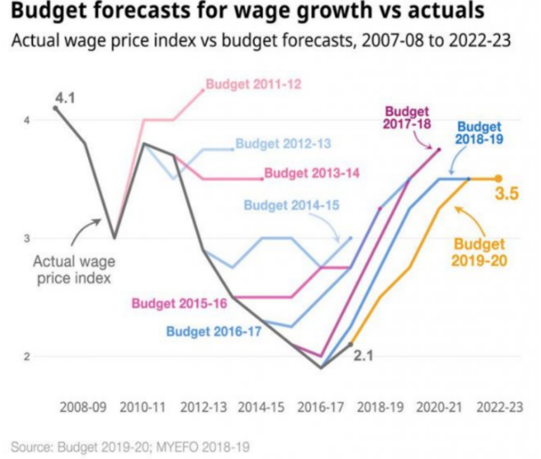
Challenges
Performance vs Interpretability:
“Like past data” is fine – even if you don’t have a mathematical definition of what “past data” means
“If the model is working, then we don’t care you can’t explain it” is logically equivalent to “If we care you can’t explain it, then the model is not working”
Better to ask: “If the model isn’t working, do you care if we can’t explain it?”
Does the model define the metric or does the metric define the model?
Does the performance on test data define which is “best”?
Can you tweak your model based on performance on test data?
What assurance do you have that your model is useful?
Business metrics confound things further!
https://www.abc.net.au/news/2019-04-29/budget-forecasts-for-wage-growth-vs-actual-growth/11053144

Slide 47
Where you can find me
LinkedIn (Craig Savage)
https://www.linkedin.com/in/craig-doc-savage
YouTube (DocSavage)
https://goo.gl/Mjp6Sc
GitHub (SavageDoc)
https://github.com/SavageDoc/

Slide 48
Acknowledgements
Microsoft
Hosting this event
Microsoft ML Server
Kaggle
Data, kernels, community
Giphy.com
So many gifs, so little time….

Slide 49

Acknowledgements
Microsoft
Hosting this event
Microsoft ML Server
Kaggle
Data, kernels, community
Giphy.com
So many gifs, so little time….

Slide 50
Thank you
Citizen Data Scientists – Melbourne
Presented by Craig “Doc” Savage

